Slide 1
Thinking back to yesterday…answer the following questions
How are stimulus and receptors related to one another?
What does the ability to detect smell rely on?

Slide 2
Thinking back to yesterday…answer the following questions
How are stimulus and receptors related to one another?
A stimulus is information received by the body. Receptors detect stimuli and then pass the information on to relevant parts of the body.
What does the ability to detect smell rely on?
Chemical receptors found in the nostrils

Slide 3
SWBAT name and describe the features of a neuron that enable it to carry messages.
SWBAT describe the difference between sensory neurons, motor neurons and interneurons.

Slide 4
Neuron
A neuron is a specialised cell transmitting nerve impulses; a nerve cell.

Slide 5
Dendrites
Dendrites are nerve endings that branch out of the cell body

Slide 6
Synapse.
A tiny gap between two nerve cells, where impulses are passed.

Slide 7
Biomass
Made out of living things, turned into pellets, that are then burned. The heat produces electricity.
But it can cause lots of trees to be chopped down!

Slide 8
Yesterday we learnt that receptors in our bodies respond to stimuli.
Where are the receptors located?
Today we are going to find out how those receptors cells function.

Slide 9
How neurons work
Nerve cells are called neurons
Neurons are cells in our body that enable us to pass messages quickly.
Scientists believe that we may have up to 100 billion neurons in our bodies, connected in paths called nerves.
Notes:
The basic unit of the nervous system is a nerve cell, or neuron.

Slide 10
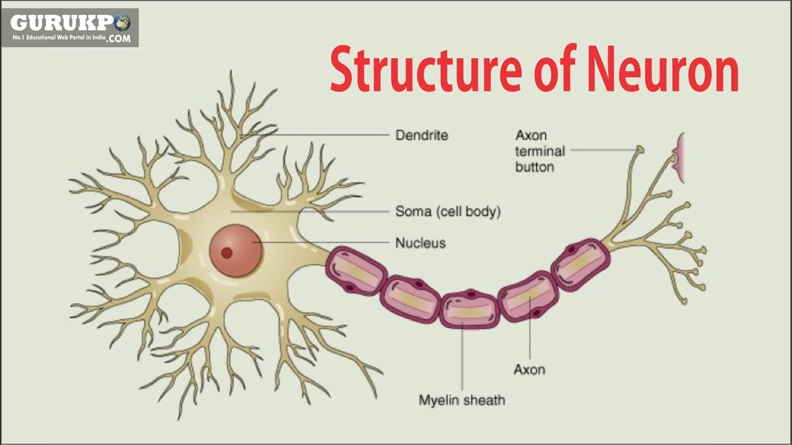

Slide 11
Nerves
Each neuron has a large cell body that connects to a long thin axon (like fibre)
An axon carries the nerve impulse away from the cell body.
The axons connecting your spinal cord to your foot can be up to 1 metre long.
At the end of the axon is a small bulb called the synaptic terminal.
Here, messages are passed to the next neuron.

Slide 12
How neurons work
Neurons
Nerves work just like electrical wires and require insulation in the same way.
The axons are covered by a fatty layer called the myelin sheath.
The myelin sheath helps to speed up a nerve impulse along an axon by controlling its path.

Slide 13
How neurons work
Dendrites are nerve endings that branch out of the cell body.
These highly sensitive, thin branches receive information and form contacts with the axons of other neurons, allowing nerve impulses to be transmitted.
Dendrites bring information to the cell body and axons take information away from the cell body.
Information from one neuron flows to another neuron across a synapse.
The synapse is a small gap separating neurons.

Slide 14
When the message reaches the end of the neuron, chemicals called neurotransmitters drift out of the synaptic terminal of an axon and across the gap to the dendrite of the next neuron.
In this way, electrical messages are passed around the body

Slide 15
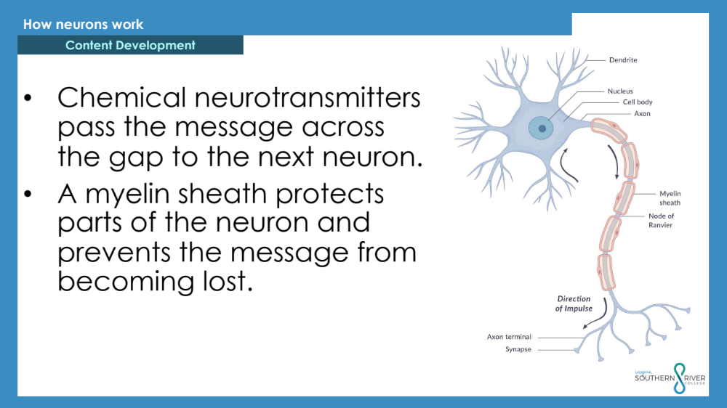
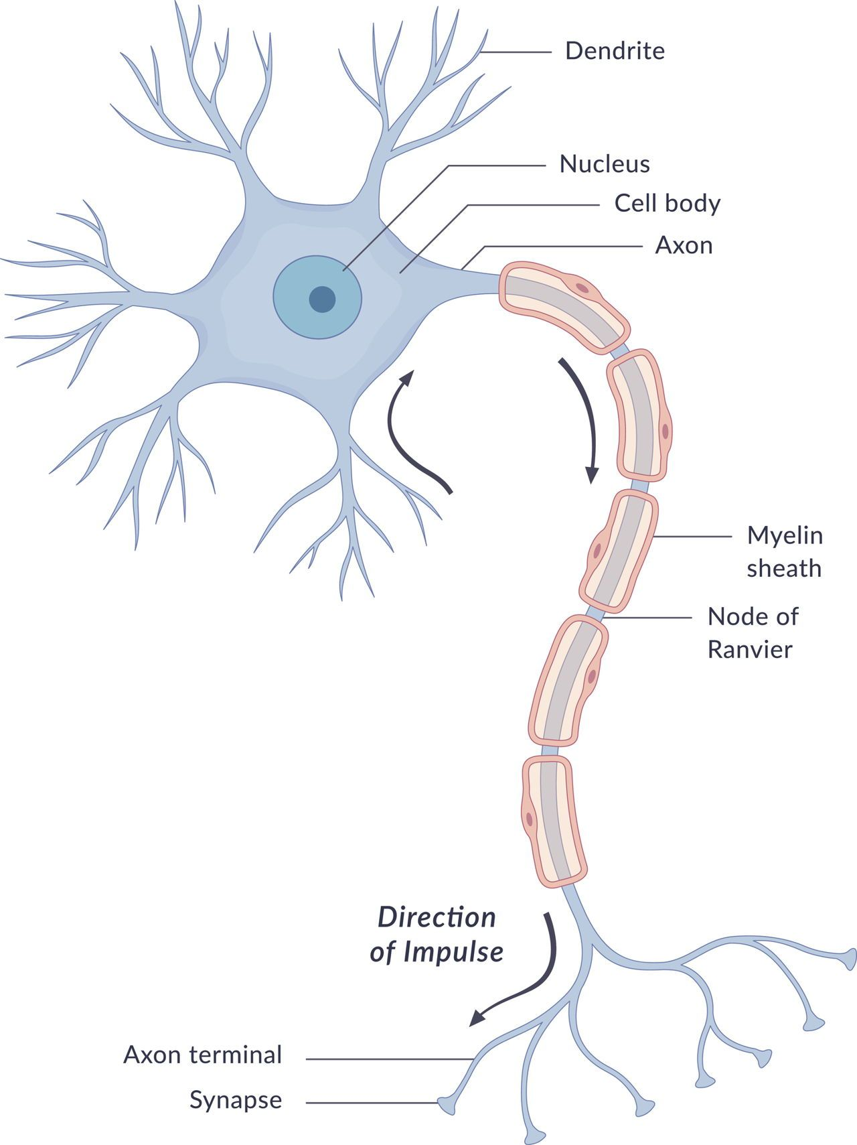
How neurons work
Chemical neurotransmitters pass the message across the gap to the next neuron.
A myelin sheath protects parts of the neuron and prevents the message from becoming lost.

Slide 16
SWBAT name and describe the features of a neuron that enable it to carry messages.
What is the role of the myelin sheath?
Name and describe the features of a neuron that enable it to carry messages

Slide 17
3 types of neurons
Sensory neurons (or afferent neurons)
are sensitive to various stimuli, collecting information from either the body’s internal environment or the outside world.

Slide 18
3 types of neurons
Motor neurons (or efferent neurons)
carry messages from the central nervous system to muscle cells throughout the body, which then carry out the response.

Slide 19
3 types of neurons
Interneurons (or connector neurons)
link sensory and motor neurons, as well as other interneurons.
Interneurons are the most common neuron in your body.
They only make connections with other neurons.

Slide 20
DO NOW
Write the five steps of the reflex arc
(you may wish to write them in the form of a flow chart)

Slide 21

DO NOW
Write the five steps of the reflex arc
(you may wish to write them in the form of a flow chart)

Slide 22
The central nervous system receives information from the peripheral nervous system

Slide 23
Central Nervous System
The central nervous system is the control centre of the body.

Slide 24
Central Nervous System
The central nervous system is the control centre of the body.
All incoming messages from your environment and your responses to them are processed through the central nervous system.
The two main features of the central nervous system are the brain and the spinal cord.

Slide 25
The Brain
Brain
The brain is the processing centre of the body and is mainly concerned with our survival.
The brain gathers information about what is going on inside and outside the body.
It then makes decisions about things such as internal changes and movements.

Slide 26
Lobes of the brain
Lobes of the brain
The cerebrum or outer section of your brain is divided into four lobes or sections.

Slide 27
Peripheral Nervous System
The peripheral nervous system is a large system made up of all the nerves outside
the central nervous system

Slide 28
The peripheral nervous system is divided into two parts.
The somatic nervous system controls voluntary skeletal muscle movements, such as waving or reaching out to take
an object.
The autonomic nervous system controls involuntary actions, which happen without our conscious control

Slide 29


Slide 30
SWBAT name and describe the features of a neuron that enable it to carry messages.
SWBAT describe the difference between sensory neurons, motor neurons and interneurons.

Slide 32
The brain:
controls and regulates body functions
communication centre

Slide 33
Parts of the brain
Why is it important to learn about the brain?
The brain is the organ that enables us to adapt to our environment - to learn.
The brain is constantly changing and everything we do changes our brain

Slide 34
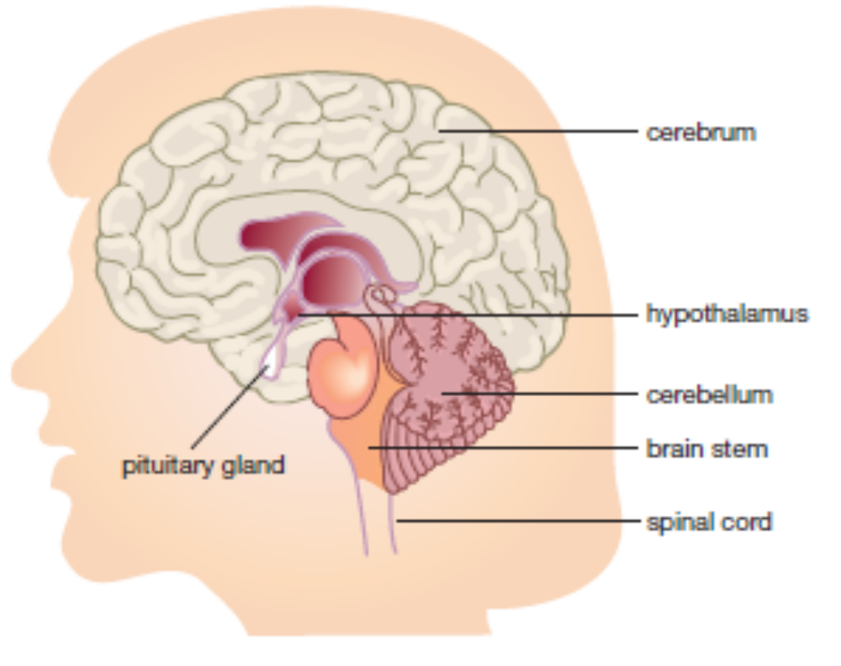
THE BRAIN
controls and regulates body functions
SIZE: humans have a very large brain for their body size, compared with other animals
Human brains have 100 million neurones
AVERAGE VOLUME: 1200–1400 mL.

Slide 35
Damage to the brain is: repaired slowly
What happens if a part of the brain is damaged?
Sometimes other parts of the brain take over the function of the damaged parts, but there are situations where brain damage is permanent.

Slide 36
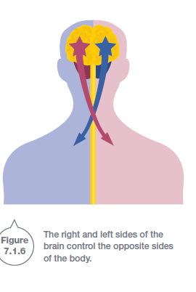
Left cerebral hemisphere:
Language and logical thinking, such as mathematical ability
Right cerebral hemisphere:
Musical and artistic ability depends on the right

Slide 37
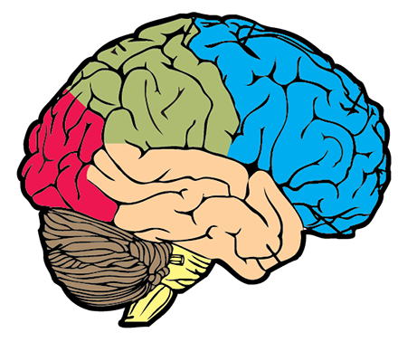

Slide 38
Parietal Lobe
Frontal Lobes
Planning
Controlling our behaviour and emotions
Problem solving
Tells us hot from cold
Tells us which way is up
Stops us from bumping into things
Organising
Memory
Decision
Occipital Lobe
Helps us see shapes and colours
Temporal Lobes
Recognising sound
Understanding speech
Speaking
Cerebellum
Stand upright
Keep our balance
Move around
Brainstem
Swallowing
Breathing
Heart rate
Blood pressure

Slide 39
Brain cap activity

Slide 40
Do not delete this slide. It is hidden from your show. You can use it to copy and paste the relevant prompt boxes into your presentation. Click once on the white space to select it for copying. Once it is in your presentation you can double click on the white space to add text. The box will automatically resize to fit your text. The next slide is also hidden and included as an example only.
Make the Connection
Check for Understanding
Teacher Cue
Vocabulary
Extension
Hints

Slide 41
This is an example slide
Check for Understanding
Have you checked if the students understand?
This is an example slide. It is used to demonstrate the use of teacher prompt boxes on the right hand side. You can delete this slide if you want, however, it is also hidden from your show.
Teacher Cue
This is a good box to remind yourself to do something. Such as get them to write their answer on their whiteboard.
Hints
If you are doing multiple steps it’s a good idea to keep them displayed. You could do that here if you have no other space.
Vocabulary
A hint to yourself to cover any difficult vocabulary.

